Slide 1


Blockchain Dev Camp: Welcome
Objectives, Curriculum, Trainers, Schedule, Exercises, Projects, Exams, Certificates
Svetlin Nakov
Technical Trainer
Academy School of Blockchain
http://kingsland.academy

Slide 2

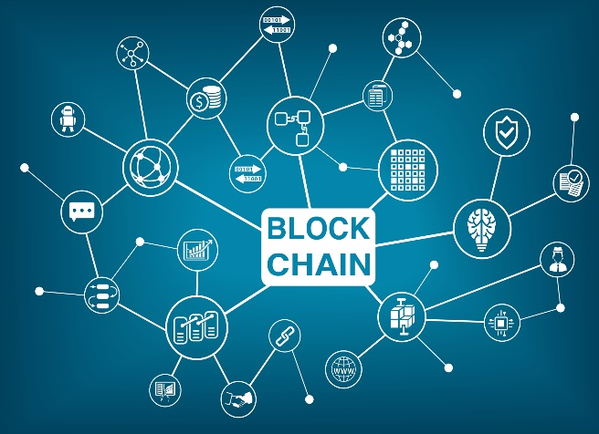

Table of Contents
Blockchain Camp Objectives
Solid blockchain Education for Developers
Curriculum and Schedule
6 weeks, full time
Trainers Team
Exercises and Projects
A Lot of Practice Every Day
Exams and Certificates

Slide 3


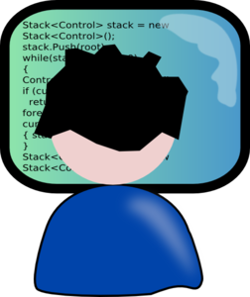

Blockchain Camp for Developers
Objectives, Target Audience, Scope

Slide 4
Blockchain Camp: Objectives
Learn the modern blockchain technologies
From a developer's perspective, with a lot of coding
A deep technical knowledge and skills about blockchain, wallets, transactions, smart contracts, Ethereum, Bitcoin, etc.
A lot of practice: exercises, labs, projects
Turn existing developers into blockchain developers
High demand for blockchain developers!
https://www.monster.com/jobs/search/?q=blockchain

Slide 5
Target Audience
Existing developers, who want to become blockchain development professionals
Fundamentals of programming skills: data types, loops, arrays, functions / methods, hash-tables, classes and objects, events
Basic JavaScript / Node.js skills
Good skills in Python, Java, C#, C++ or other language
Entrance exam may apply
Live coding in language by choice

Slide 6



Curriculum
Scope, Curriculum and Schedule

Slide 7


Solid Curriculum
Up-to-date curriculum
Deep technical details, not just basics
Learn by doing: write code every day
Aligned with the industry trends
Partnership with many blockchain startups
Best graduates get hiring offers

Slide 8
Scope and Curriculum
Blockchain concepts
Technical details, wallets, transactions, consensus, networks, smart contracts, DApps, etc.
Building your own blockchain network
Smart contracts
Writing smart contracts (using Solidity and other platforms)
Writing DApps (decentralized blockchain applications)
Blockchain networks: Ethereum, Bitcoin, RSK, Hyperledger, …

Slide 9
Schedule
Week #1: Blockchain Fundamentals
Week #2: Blockchain Advanced Concepts
Week #3: Smart Contracts, Solidity and DApps
Week #4: Advanced Smart Contract Development
Week #5: Team Project
Week #6: Individual Final Project

Slide 10



Trainers Team

Slide 11
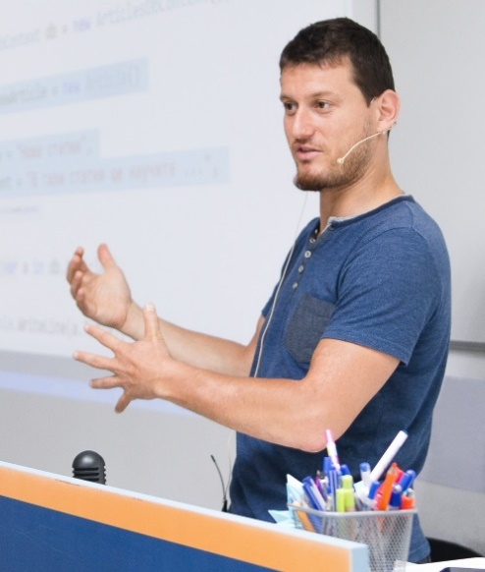
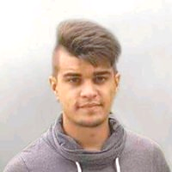
Trainers Team
Experienced trainers from the blockchain industry
Svetlin Nakov
linkedin.com/in/nakov
Sevgin Mustafov
linkedin.com/in/sevgin-mustafov-712bbbb9
Assistant trainers

Slide 12



Exercises, Labs, Projects
Practice: Live Coding Every Day

Slide 13
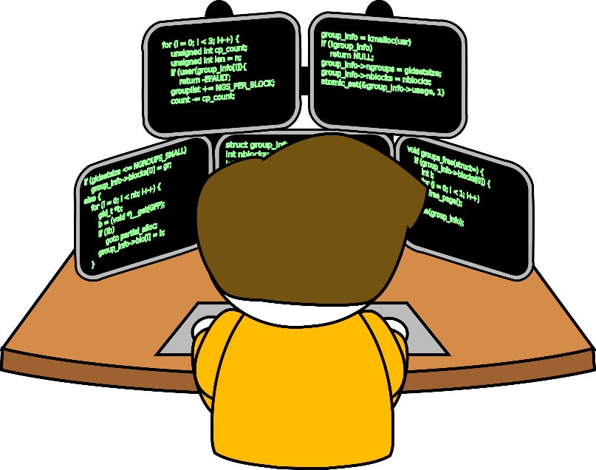
Exercises, Labs and Practical Projects
A lot of coding every day
At least 50% coding exercises
Step-by-step tutorials to follow
Practical projects
Learn by doing
Teamwork
Individual projects

Slide 14


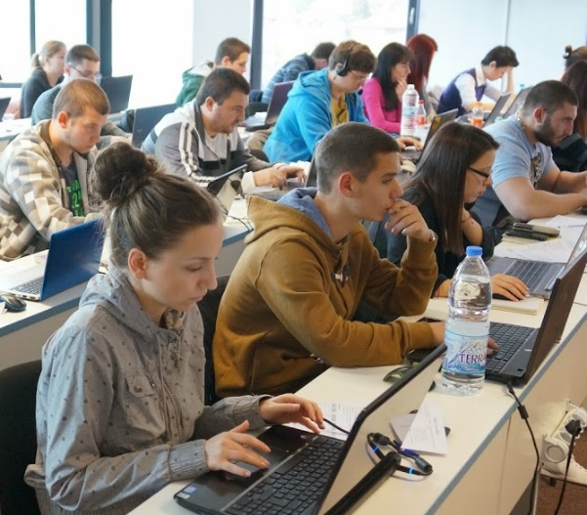
Evaluation and Certificates
Exercises, Exams, Quizzes, Projects

Slide 15

Exams
Quizzes every week
Review of the content from the last week
Exercises every day (coding and practicing)
Step-by-step tutorial style exercises
Assistance from the trainers
Practical projects
Learn by doing
Assistance from the trainers

Slide 16
Evaluation and Certificates
Evaluation
Based on several components:
Certificates
For the successful participants only
~ 70% of the score required
Component | Weight
Quizzes | 10%
Assignments | 20%
Final Project | 70%

Slide 17

Summary
Blockchain Dev Camp
Solid blockchain education for developers
Practical approach: learn by doing
Intensive format: 6 weeks every day
Up-to-date curriculum, aligned with industry needs
Experienced trainers from the industry
Practical projects: teamwork and individual
Certificates and job offers for successful graduation

Slide 18
Blockchain Dev Camp: Welcome
http://www.kingsland.academy

